Slide 1
Estimating Distributions
Review common moments: μ, σ²
Motivation: Why estimate distributions?
Four standard methods:
Method of Moments (MOM)
Maximum Likelihood Estimation (MLE)
Maximum a Posteriori (MAP)
Kernel Density Estimation (KDE)
Parametric vs nonparametric methods
Ryan Henning

Slide 2
Review common moments

Slide 3


Review: Moments of a random variable X
n^{th} Raw Moment:
What does the E operator do?
Why do we call this the “central” moment?
(hint: look at the equation)
n^{th} Central Moment:
Notes:
ASK: What is a random variable?
\mu_n = E[(X)^n]
\mu'_n = E[(X - E[X])^n]

Slide 4

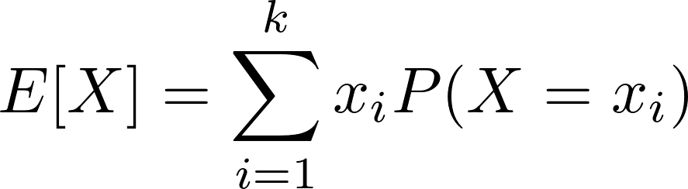
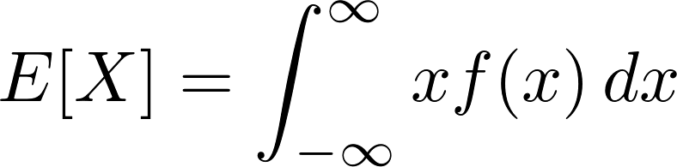
Review: 1st Raw Moment: Mean
Fill in the blank:
P is the “Probability ___ Function”
For discrete random variables with k possible outcomes:
Fill in the blank:
f is the “Probability ___ Function”
For continuous random variables:
Notes:
\mu = E[X]
E[X] = \sum_{i=1}^k x_i P(X=x_i)
E[X] = \int_{-\infty}^{\infty} x f(x) \,dx

Slide 5

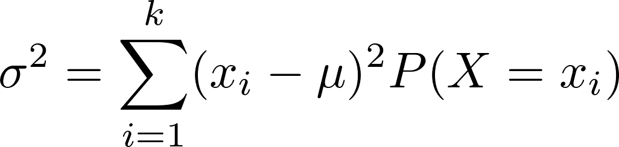
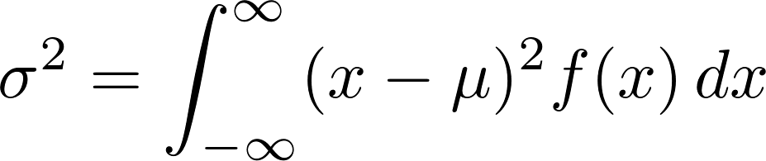
Review: 2nd Central Moment: Variance
For discrete random variables with k possible outcomes:
Variance measures the “spread” of data. Can you see that in the equations?
For continuous random variables:
Notes:
\sigma^2 = E[(X - E[X])^2]
\sigma^2 = \sum_{i=1}^k (x_i-\mu)^2 P(X=x_i)
\sigma^2 = \int_{-\infty}^{\infty} (x-\mu)^2 f(x) \,dx

Slide 6
Why Estimate Distributions?

Slide 7
Why estimate distributions?
Example 1: You have data on how many people order cakes every day at your bakery, and you want to estimate the probability of selling out.
Example 2: You have data on how often your car breaks down, and you want to know your chances of safely crossing the country in it.
Example 3: You have data on how many people visit your website each day, and you want to know the probability of your servers being overloaded.
Credit to Jancsy for these examples.

Slide 8
Method of Moments (MOM)

Slide 9
Method of Moments (MOM)
Overview:
Assume an underlying distribution for your domain. E.g. Poisson, Bernoulli, Binomial, Gaussian
Compute the relevant sample moments. E.g. Mean, Variance
Plug the sample moments into the PMF/PDF of the assumed distribution.

Slide 10
Example 1: Method of Moments
Your website visitor log shows the following number of visits for each of the last seven days: [6, 4, 7, 4, 9, 3, 5]. What’s the probability of zero visitors tomorrow?
Which underlying distribution should we assume?
Poisson! Let’s look at Wikipedia to remind ourselves what it is. :)
What moment should we estimate?
The mean. Our mean estimate will become the estimate for the only parameter used in the Poisson distribution: λ
Notes:
https://en.wikipedia.org/wiki/Poisson_distribution

Slide 11

Example 1 (con’t): Method of Moments
Your website visitor log shows the following number of visits for each of the last seven days: [6, 4, 7, 4, 9, 3, 5]. What’s the probability of zero visitors tomorrow?
From our samples, estimate the mean:
Our mean estimate is used to estimate λ:

Slide 12
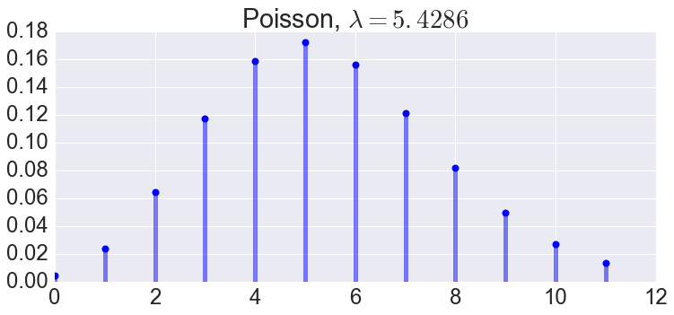
Example 1 (con’t): Method of Moments
print scipy.stats.poisson.pmf(0, lmda) 0.00438936184278
Notes:
import matplotlib as mpl
import matplotlib.pyplot as plt
import seaborn
%matplotlib inline
from scipy import stats
mpl.rcParams.update({
'font.size' : 24.0,
'axes.titlesize' : 'large',
'axes.labelsize' : 'medium',
'xtick.labelsize' : 'medium',
'ytick.labelsize' : 'medium',
'legend.fontsize' : 'large',
})
mu = (6 + 4 + 7 + 4 + 9 + 3 + 5) / 7.
print stats.poisson.pmf(0, mu)
x = np.arange(stats.poisson.ppf(0.00001, mu),
stats.poisson.ppf(0.99, mu))
fig, ax = plt.subplots(1, 1, figsize=(12, 5))
ax.plot(x, stats.poisson.pmf(x, mu), 'bo', ms=8, label='poisson pmf')
ax.vlines(x, 0, stats.poisson.pmf(x, mu), colors='b', lw=5, alpha=0.5)
ax.set_title("Poisson, $\lambda={:.4f}$".format(mu))

Slide 13
Example 2: Method of Moments
You flip a coin 100 times. It comes up heads 52 times. What’s the MOM estimate that in the next 100 flips the coin will be heads <= 45 times?
Which underlying distribution should we assume?
Binomial… note: We really only have one binomial sample here.
What moment should we estimate?
The mean. We actually only have one sample here where the result is 52. So the mean is 52.
Notes:
https://en.wikipedia.org/wiki/Binomial_distribution

Slide 14


Example 2 (con’t): Method of Moments
You flip a coin 100 times. It comes up heads 52 times. What’s the MOM estimate that in the next 100 flips the coin will be heads <= 45 times?
From our one binomial sample, we know:
The binomial distribution has mean:
What does MOM say to do next?
Use the sample moments to estimate the distribution parameters. In this case, the parameter we need to estimate is p.

Slide 15
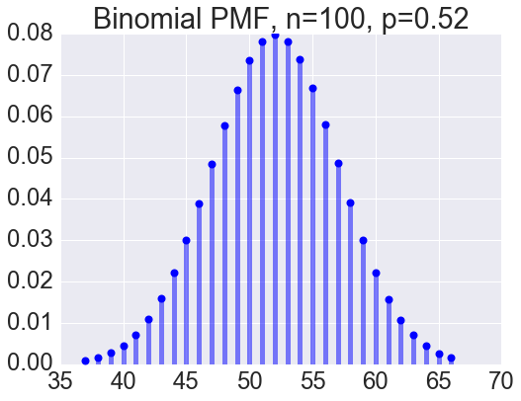




Example 2 (con’t): Method of Moments
Probability in the next 100 flips the coin will be heads <= 45 times... 9.67%
Notes:
import matplotlib as mpl
import matplotlib.pyplot as plt
import seaborn
%matplotlib inline
from scipy import stats
mpl.rcParams.update({
'font.size' : 24.0,
'axes.titlesize' : 'large',
'axes.labelsize' : 'medium',
'xtick.labelsize' : 'medium',
'ytick.labelsize' : 'medium',
'legend.fontsize' : 'large',
})
n = 100
p = 0.52
print stats.binom.cdf(45, n, p)
x = np.arange(stats.binom.ppf(0.001, n, p),
stats.binom.ppf(0.999, n, p))
fig, ax = plt.subplots(1, 1, figsize=(8, 6))
ax.plot(x, stats.binom.pmf(x, n, p), 'bo', ms=8, label='binom pmf')
ax.vlines(x, 0, stats.binom.pmf(x, n, p), colors='b', lw=5, alpha=0.5)
ax.set_title("Binomial PMF, n=100, p=0.52")

Slide 16
Maximum Likelihood Estimation (MLE)

Slide 17
Maximum Likelihood Estimation (MLE)
Overview:
Law of Likelihood: If P(X|H1) > P(X|H2), then the evidence supports H1 over H2.
Question: Which hypothesis does the evidence most strongly support?
Answer: The hypothesis H that maximizes P(X|H), which is found via MLE.

Slide 18
Maximum Likelihood Estimation (MLE)
Overview:
Assume an underlying distribution for your domain. (just like with MOM) E.g. Poisson, Bernoulli, Binomial, Gaussian
Define the likelihood function. We want to know the likelihood of the data we observe under different distribution parameterizations.
Choose the parameter set that maximizes the likelihood function.

Slide 19
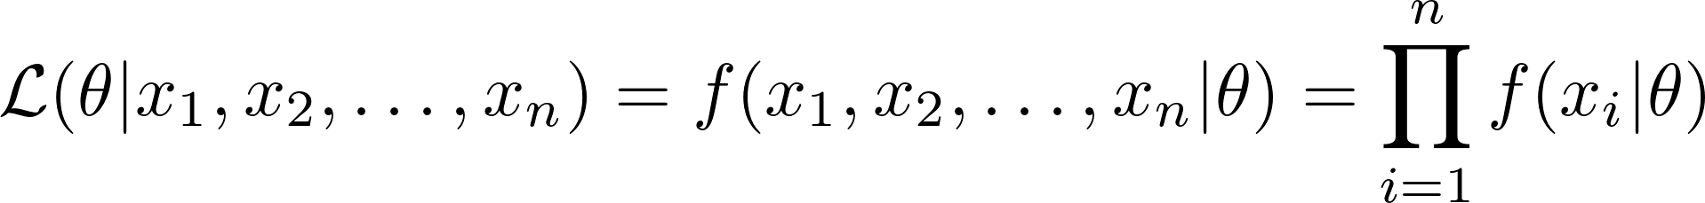
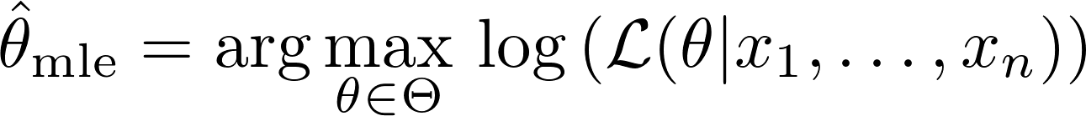
Tell me more about MLE...
True because we assume X is i.i.d. Recall, what does i.i.d. mean?
We will find θ to maximize the log-likelihood function:
Whoa whoa… what? Let’s talk about it.
Notes:
f(x_1, x_2, \dots, x_n | \theta) = f(x_1|\theta) f(x_2|\theta) \dots f(x_n|\theta)
\mathcal{L}(\theta | x_1, x_2, \dots, x_n) = f(x_1, x_2, \dots, x_n | \theta) = \prod_{i=1}^n f(x_i | \theta)
\hat{\theta}_{\text{mle}} = \arg\max_{\theta \in \Theta} \, \text{log}\left( \mathcal{L}(\theta | x_1, \dots, x_n) \right)

Slide 20
Example 3: Maximum Likelihood Estimation
You flip a coin 100 times. It comes up heads 52 times. What’s the MOM estimate that in the next 100 flips the coin will be heads <= 45 times?
Yep, same example...
Which underlying distribution should we assume?
Binomial… (like last time)
… now we need to define our likelihood function...

Slide 21
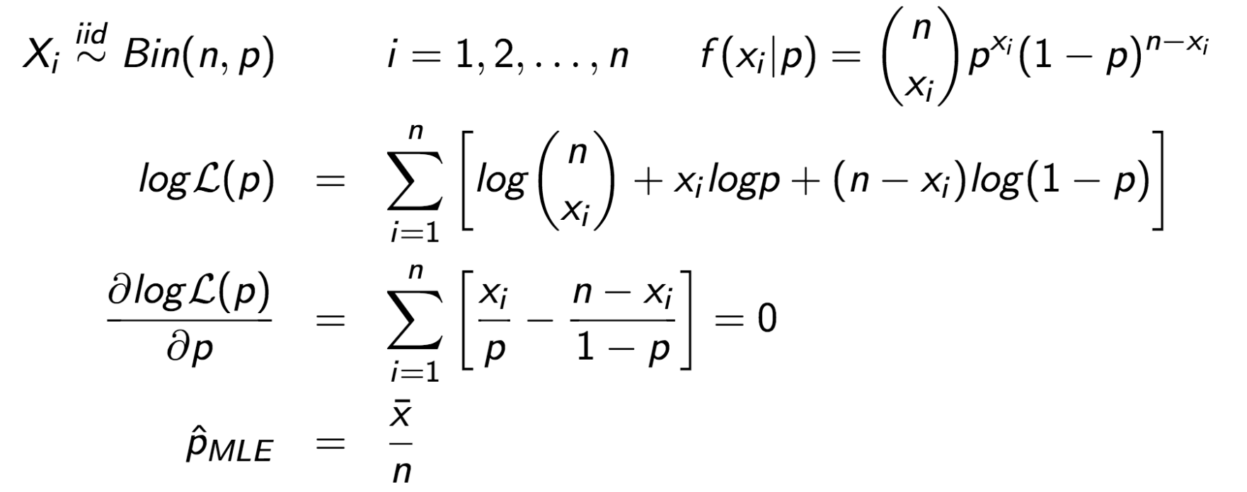
Example 3 (con’t): Maximum Likelihood Estimation
For the Binomial distribution, MOM and MLE give the same answer!

Slide 22
Maximum a Posteriori (MAP)

Slide 23


Maximum a Posteriori (MAP)
Recall, MLE finds θ to maximize:
Whereas, MAP finds θ to maximize:
Notes:
https://en.wikipedia.org/wiki/A_priori_and_a_posteriori
f(x_1, x_2, \dots, x_n | \theta)
f(\theta | x_1, x_2, \dots, x_n)

Slide 24
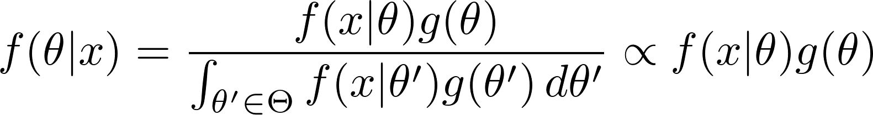
Maximum a Posteriori (MAP)
MLE → MAP, just use Bayes’ Theorem
MLE is just this part.
Notes:
f(\theta | x) = \frac{ f(x|\theta) g(\theta) }{ \int_{\theta' \in \Theta} f(x|\theta') g(\theta') \,d\theta' } \propto f(x|\theta) g(\theta)

Slide 25
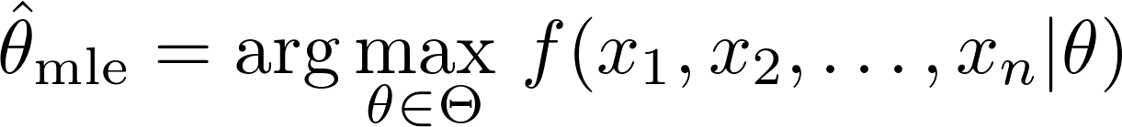
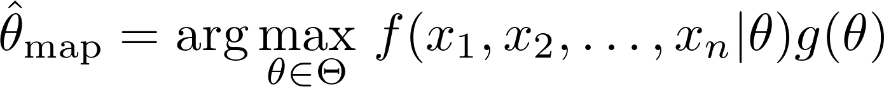
MLE vs MAP
MLE solves:
MAP includes the prior belief.
MAP solves:
What if all θ are equally likely?
Notes:
\hat{\theta}_{\text{mle}} = \arg\max_{\theta \in \Theta} \, f(x_1, x_2, \dots, x_n | \theta)
\hat{\theta}_{\text{map}} = \arg\max_{\theta \in \Theta} \, f(x_1, x_2, \dots, x_n | \theta) g(\theta)

Slide 26
Kernel Density Estimation (KDE)

Slide 27
Nonparametric Techniques
Question: How can we model data that does not follow a known distribution?
Answer: Use a nonparametric technique.

Slide 28
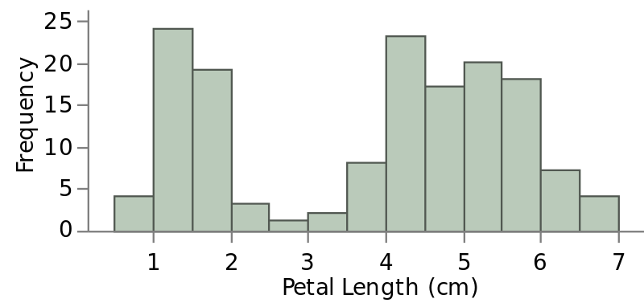
Histograms
A histogram groups continuous data into discrete intervals and displays relative frequencies. But it’s not a smooth distribution. :(
Notes:
https://en.wikipedia.org/wiki/File:Iris_Petal_Length_Histogram.svg

Slide 29
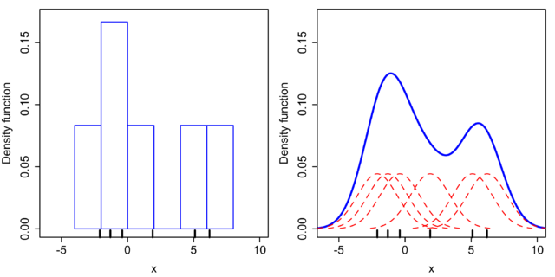
Kernel Density Estimation (KDE)
KDE is a nonparametric way to estimate the PDF of a random variable. KDE smooths the histogram by summing “kernel functions” (usually Gaussians) instead of binning into rectangles.
Notes:
https://en.wikipedia.org/wiki/File:Comparison_of_1D_histogram_and_KDE.png

Slide 30
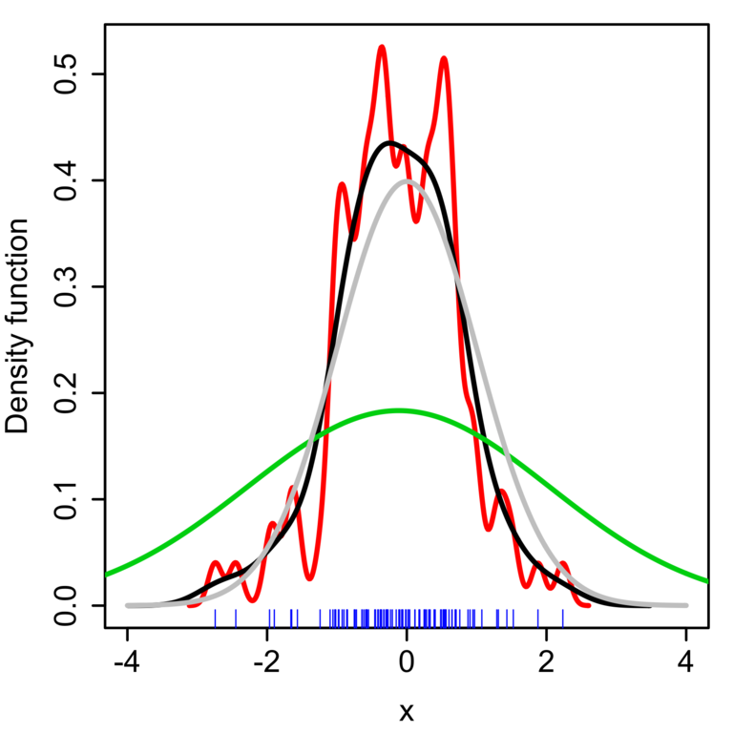
Kernel Density Estimation (KDE)
Kernel functions have a bandwidth parameter to control under- and over-fitting.
Each curve on the right shows an estimated PDF with different bandwidths.
Notes:
https://en.wikipedia.org/wiki/File:Comparison_of_1D_bandwidth_selectors.png

Slide 31
Parametric vs Nonparametric Methods

Slide 32
Estimating Distributions
Parametric vs Nonparametric Methods
Parametric: We assume an underlying distribution, then we use our data to estimate the parameters of that underlying distribution. E.g. Using:
Method of Moments (MOM)
Maximum Likelihood Estimation (MLE)
Maximum a Posteriori (MAP)
Nonparametric: We don’t assume any single underlying distribution, but instead we fit a combination of distributions to the observed data. E.g. Using:
Kernel Density Estimation (KDE)

Slide 33
When to use each method? (Parametric vs Nonparametric)
Parametric methods:
Based on assumptions about the distribution of the underlying population and the parameters from which the sample was taken.
If the data deviates strongly from the assumptions, could lead to incorrect conclusions.
Nonparametric methods:
NOT based on assumptions about the distribution of the underlying population.
Generally not as powerful -- less inference can be drawn.
Interpretation can be difficult… what does the wiggly curve mean?

Slide 34
Sampling
Population Inference & Sampling
Central Limit Theorem
Confidence Intervals
Bootstrapping
Ryan Henning
Notes:
Each of these topics has to do with sampling. First, how to do random sampling. Then CLT, which is in regard to the distribution of samples of samples. Then confidence intervals, which can be seen as one sample which is 95% likely to contain the true param. Then Bootstrapping, which is a kind of “resampling”.

Slide 35
Population Inference & Sampling

Slide 36
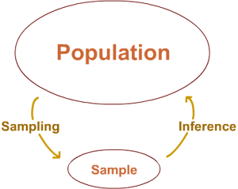
Population Inference
Start with a question/hypothesis
Design an experiment
Collect data
Analyze
Check the results
Repeat? Redesign?
Notes:
Question/hypothesis: the world is yours, dream
Design an experiment: that’s mostly the topic of tomorrow with hypothesis testing
Collect data: YOU GOTTA SAMPLE, BUT HOW!?
Analyze: many things you can do in this step, we’ll talk about bootstrapping today
Check the result: You have a brain, and stats is often subjective, does the result meet your expectation? Does it reveal anything to indicate that the experiment was poorly done?
Repeat: Did the result uncover issues or further questions? Do you need to do a followup experiment?

Slide 37
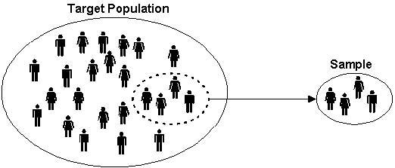
Collecting data: Taking a sample
A sample should be representative of the population.
Random sampling is often the best way to achieve this. Ideally: each subject has an equal chance of being in the sample.

Slide 38
Random sampling is surprisingly hard to do...
Scenario: You want to estimate the percentage of dog owners in Austin.
Method 1: Go to the nearby dog park and ask random people if they own dogs until you have n responses.
Method 2: Stand on 6th and Congress and ask random people if they own dogs until you have n responses.
Method 3: Repeat n times: Pick a random neighborhood in Austin (weighted by census data per neighborhood), go to that neighborhood, ask random people you see if they own dogs until you get 1 response.
Notes:
Problem with method 1 is obvious.
Problem with method 2 is: (many possible answers) One answer: You are sample only people who live/work/go downtown. That might not represent the greater Austin population.
Problem with method 3 is: (again, many possible answers) A few answers: (1) people with dogs go outside more (e.g. to walk their dog), (2) depending on the time of day, maybe dog people have non 9-5 jobs, (3) maybe dog people are more likely to take you survey instead of ignoring you.
Populations have build-in patterns. It’s hard to sample randomly such that each person in the population has equal chance of being picked.

Slide 39

Random sampling… just do the best you can.
Often it’s impossible to do perfect random sampling.
So…
do the best you can,
call out possible objections, and
make a case for why you think your results are valid.
Notes:
https://my.wlc.edu/ICS/Academics/MAT/MAT__117/1314_SP-MAT__117-02/Chapter_08.jnz
If you try hard enough, you can find issues with ANY statistical experiment.

Slide 40
Random sampling in the digital age...
You might think that random sampling in a digital context is easier, and you’re right! But there are still gotchas.
Scenario: Slack is testing a new features (“channel polling”, a way to survey people in a channel). They’d like to test the feature on only a subset of their users (n), then draw inference about their entire userbase.
Method 1: SELECT user_id FROM users LIMIT n;
Method 2: SELECT user_id FROM users ORDER BY RAND() LIMIT n;
Notes:
Issue with method 1: There will be some order to your table. Probably ordered by row creation date, so you’d select your first n users, which is most likely your friends and family!
Issue with method 2: Ignoring that ORDER BY RAND() is very inefficient… for most web-based products/features this would be good. Unless you’re Slack and you’re testing a new chat feature or something. You’d instead want to subset all users from randomly selected organizations.
Nonetheless, this is easier than surveying people.

Slide 41

Central Limit Theorem
Notes:
\bar{X} \sim N(\mu, \frac{\sigma^2}{n})

Slide 42
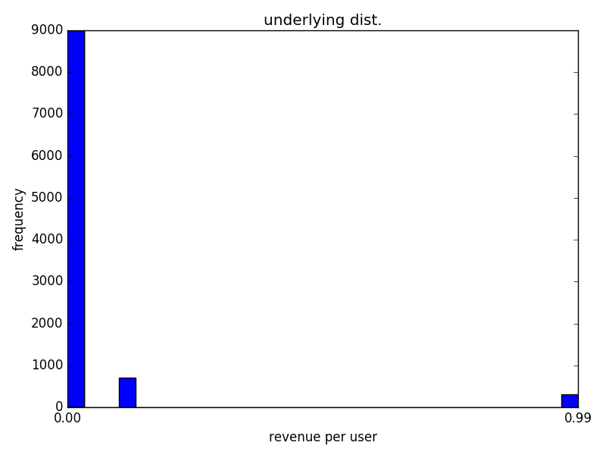
Distribution of website revenue per visitor
Underlying Distribution:
Random variable: X = revenue per visitor | P(X):
X = $0.00 (no revenue) | 90%
X = $0.10 (ad-click) | 7%
X = $0.99 (app purchase) | 3%
Notes:
We have a website with ads and a product. Here’s our distribution of revenue per user. Most users (90%) do nothing that generates revenue. Some click ads (7% do, causes a little revenue) and some (3%) buy our app!

Slide 43
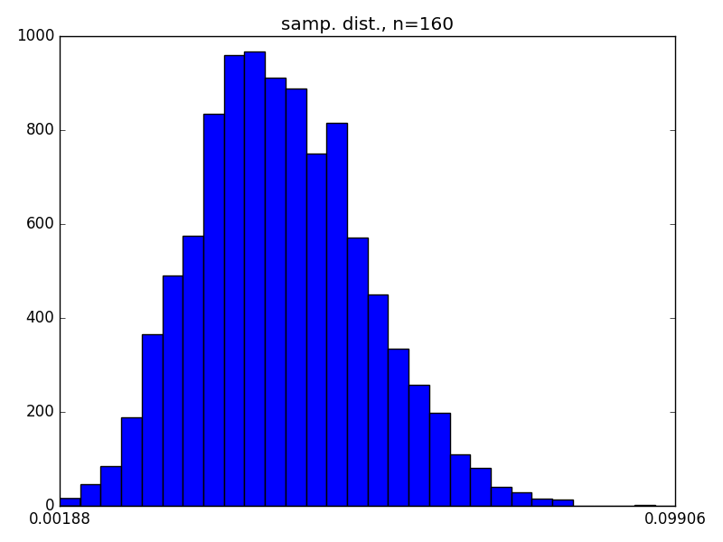


Distribution of sample means
Collect n samples from the website revenue distribution, calculate the sample mean
Repeat 10,000 times, we get:
Plot all 10,000 sample means.
Notes:
Previously we were plotting the histogram of single samples. What if we plot a histogram of sample means? Here’s what you get! Here’s the histogram of sample means where each mean is the average of 160 website users.
This is called the “sampling distribution”.

Slide 44
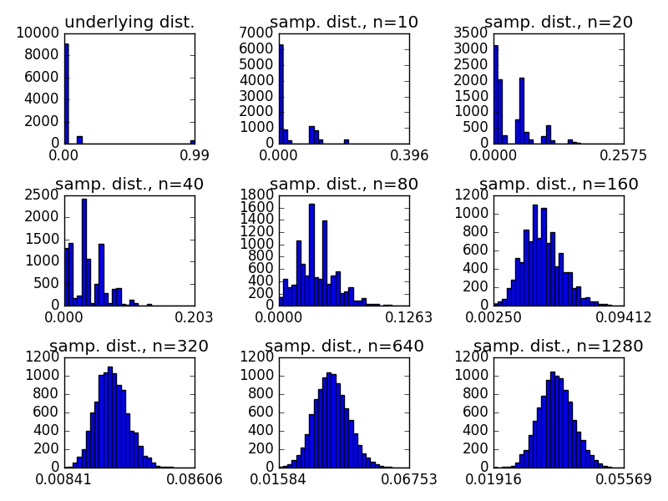
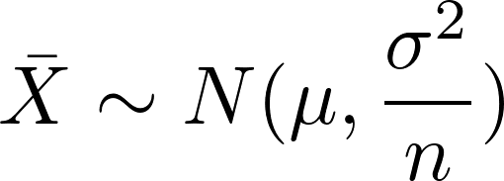
Central Limit Theorem
The distribution of sample means (aka, the “sampling distribution”) is normally distributed. *
* Under certain conditions; e.g. sufficiently large sample sizes, and i.i.d. r.v.
Notes:
What is the Central Limit Theorem?
It states: The distribution of sample means (aka, the “sampling distribution”) is normally distributed, no matter what the underlying distribution is!
'''
Play with the central limit theorem.
'''
import matplotlib.pyplot as plt
import numpy as np
def sample_from_unknown_distribution(num_samples):
uniform = np.random.uniform(0., 1., num_samples)
vals = []
for val in uniform:
if val < 0.9:
val = 0.00
elif val < 0.97:
val = 0.10
else:
val = 0.99
vals.append(val)
return np.array(vals)
def plot_histogram(data, bins=30):
plt.xticks(np.linspace(np.min(data), np.max(data), 2))
plt.hist(data, bins)
def plot_histogram_alt(data, bins=30):
hist, bins = np.histogram(x, bins=bins)
width = 0.7 * (bins[1] - bins[0])
center = (bins[:-1] + bins[1:]) / 2
plt.bar(center, hist, align='center', width=width)
plt.xticks(np.linspace(0., 0.3, 2))
if __name__ == '__main__':
num_datapoints = 10000
# 1-sample
x = sample_from_unknown_distribution(num_datapoints)
plt.subplot(3, 3, 1)
plt.title("underlying dist.")
#plt.xlabel("revenue per user")
#plt.ylabel("frequency")
plot_histogram(x)
# n-samples
for index, n in enumerate([10, 20, 40, 80, 160, 320, 640, 1280]):
x = [np.mean(sample_from_unknown_distribution(n))
for i in range(num_datapoints)]
plt.subplot(3, 3, index+2)
plt.title("samp. dist., n="+str(n))
#plot_histogram_alt(x)
plot_histogram(x)
plt.tight_layout()
plt.show()

Slide 45
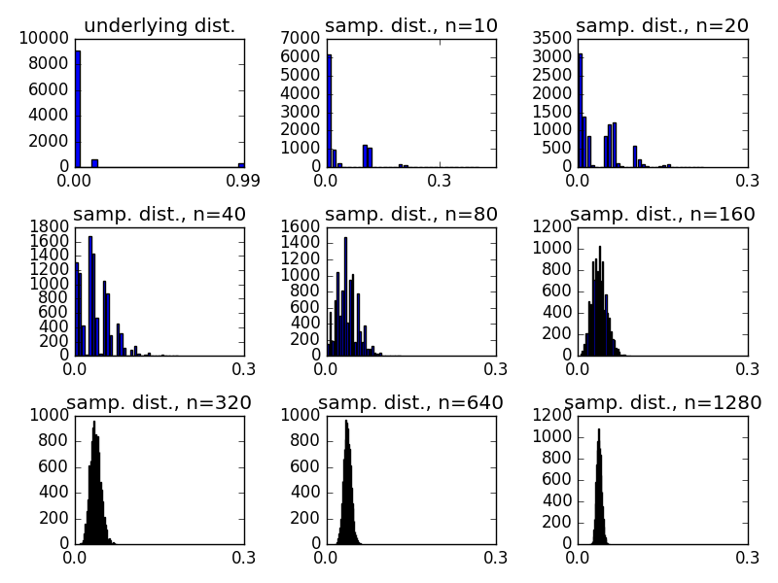
Central Limit Theorem: What happens when the sample size increases?
Same charts as the previous slide, but now the scale of each x-axis is the same!
Now we can see: What happens when the sample size increase?
Notes:
What happens to the sampling distribution when the sample size increases?
1. The distribution becomes more normal.
2. The variance & standard deviation decreases.
What happens to the mean of the sampling distribution when the sample size increases?
It stays the same. (But recall, the variance decreases.)

Slide 46
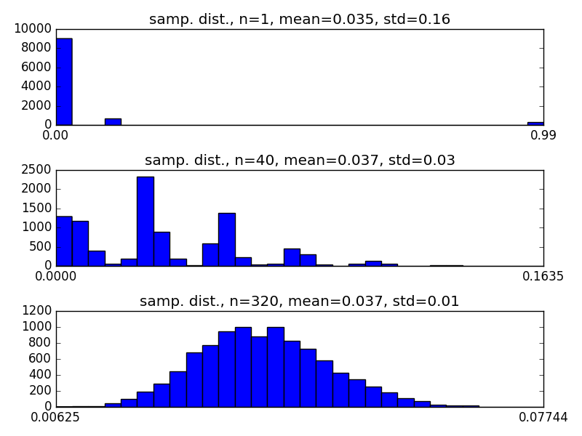



Central Limit Theorem: Std. Dev precise relationship to sample mean
Let the underlying distribution have mean and std. dev.
The sampling distribution's mean and std. dev. will equal:
Notes:
We can see the exact relationship between std dev and the sample size here.
We’ll see this “divide by the root of the sample size” later in this presentation.

Slide 47
Intuitively, does the Central Limit Theorem make sense?
Intuitively, why does the mean stay the same in each histogram?
Intuitively, why does the std. dev. decrease as the sample size increases?

Slide 48
Confidence Intervals

Slide 49
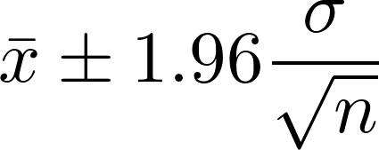
Confidence Interval
A confidence interval (CI) is an interval estimate of a population parameter.
The typical level of confidence is 95%, but they can be calculated for any level.
For example, a 95% CI for the population mean is given by:
Why assuming the normal distribution here?
Where does the sqrt(n) come from?
Grr. We don’t know sigma...
conf = 0.95 scipy.stats.norm.ppf((1 + conf) / 2.) # <-- handling two-sided-ness
Notes:
\bar{x} \pm 1.96 \frac{\sigma}{\sqrt{n}}

Slide 50
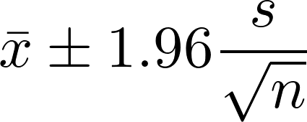
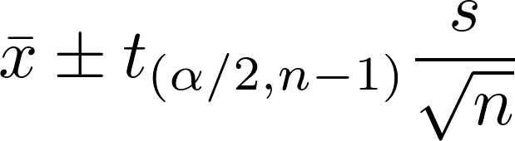
Confidence Interval (con’t)
Since we don’t know sigma, we can substitute s for it:
Btw, this value is the “standard error of the mean (SEM)”
When n is small (<30), we should use the t-distribution instead of the normal:
Notes:
\bar{x} \pm t_{(\alpha/2,n-1)} \frac{s}{\sqrt{n}}

Slide 51
Bootstrapping

Slide 52
Bootstrap Sampling
Estimates the sampling distribution of an estimator by sampling with replacement from the original sample.
Advantages:
Completely automatic
Available regardless of how complicated the estimator may be
Often used to estimate the standard errors and confidence intervals of an unknown population parameter.
Recall, how is the “sampling distribution” distributed when the estimator is the sample average?

Slide 53
Bootstrap Sampling
Method:
Start with your dataset of size n
Sample from your dataset with replacement to create 1 bootstrap sample of size n
Repeat B times
Each bootstrap sample can then be used as a separate dataset for estimation and model fitting

Slide 54
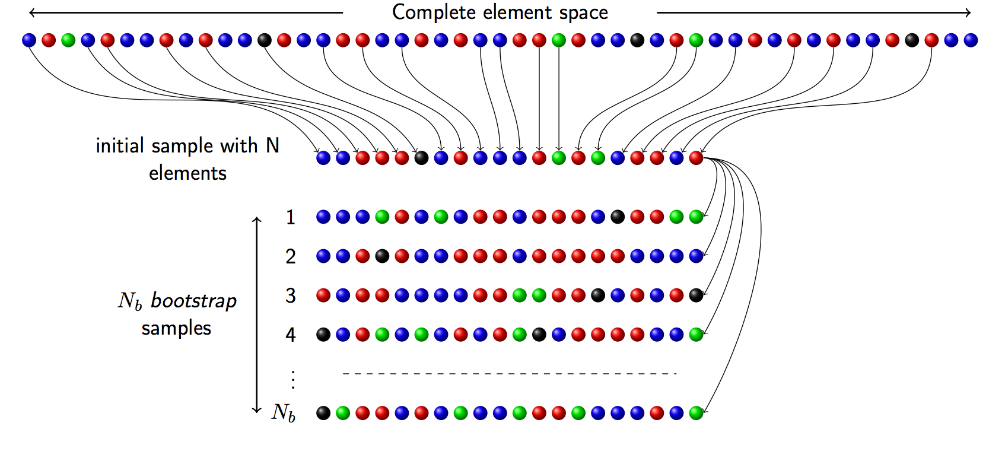
Bootstrap Sampling

Slide 55

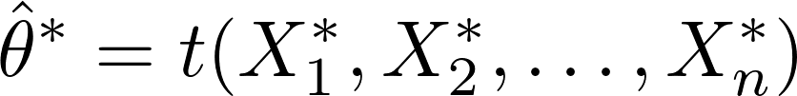
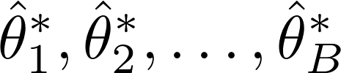
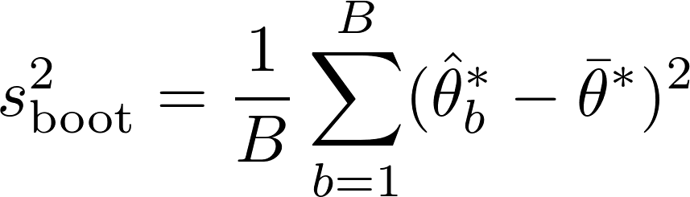
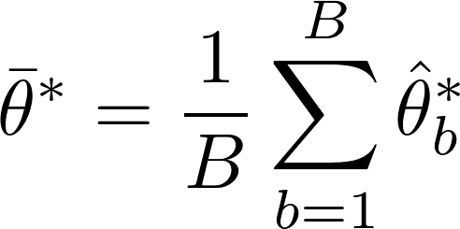
Bootstrap Variance
Draw a bootstrap sample:
Calculate bootstrap estimate of your parameter (the parameter you’re interested in):
Repeat steps 1 and 2, B times to get:
Calculate the bootstrapped variance:
where
Notes:
s_{\text{boot}}^2 = \frac{1}{B} \sum_{b=1}^{B} ( \hat{\theta}_b^* - \bar{\theta}^* )^2
\bar{\theta}^* = \frac{1}{B} \sum_{b=1}^{B} \hat{\theta}_b^*

Slide 56
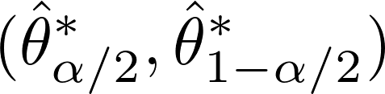

Bootstrap Confidence Intervals
Percentile method:
Interval assuming approximately normal bootstrap sampling distribution:
Notes:
\bar{\theta}^* \pm 1.96 \, s_{\text{boot}}
(\hat{\theta}_{\alpha/2}^*, \hat{\theta}_{1-\alpha/2}^*)

Slide 57
When to Bootstrap
When the theoretical distribution of the statistic (parameter) is complicated or unknown. (E.g. Median or Correlation)
When the sample size is too small for traditional methods.
Favor accuracy over computational cost.

